Slide 1
Group Work Protocols
By Kirsty, Paul and Ryan

Slide 2

Meetings
Arrange our meetings.
Have our own views.
Be open-minded.

Slide 3

Timing Of Work
After scheduled classes.
Or come in extra days.

Slide 4
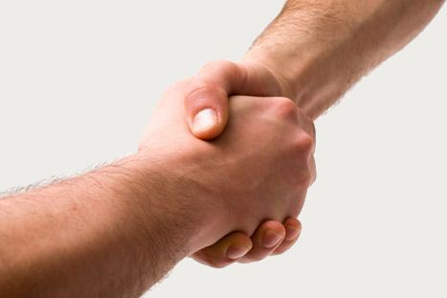
Work Commitment
Share workload by rotating who is typing.
Everyone spends the same amount of time working.
Collaborating rather than co-operation.
Good communication.
Confront each other and ask if anyone has any problems.

Slide 5
Goals/Motivation
All have the same expectations- wanting to do the best we can.

Slide 6
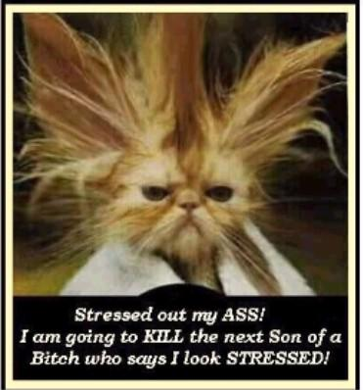
Dealing with Stress
Not pulling their own weight.
Not showing up at arranged meetings.
We would avoid this by communication.

Slide 7
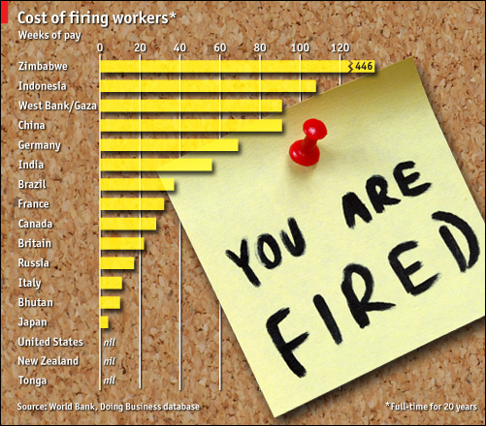
Sacking Members

Slide 8
Other Factors
We agree.
We listen to each other.
Our slogan….Co-operation, Collaboration and Communication. The to key our success!

